Slide 1
Data Science 21CSS303T

Slide 2
Unit II
Unit-2: DATA WRANGLING, DATA CLEANING AND PREPARATION 10 hours
Data Handling: Problem faced when handling large data-General techniques for handling large volume of data- General programming tips for dealing large data sets
Data Wrangling: Clean, Transform, Merge, Reshape: Combining and Merging Datasets, Merging on Index, Concatenate, Combining with overlap, Reshaping, Pivoting
Data Cleaning and Preparation: Handling Missing Data, Data Transformation, String Manipulation, summarizing, Binning, classing and Standardization, outlier/Noise& Anomalies.

Slide 3
Problems faced when handling large data
A large volume of data poses new challenges, such as overloaded memory and algorithms that never stop running. It forces you to adapt and expand your repertoire of techniques. But even when you can perform your analysis, you should take care of issues such as I/O (input/output) and CPU starvation, because these can cause speed issues.

Slide 4
Problems faced when handling large data
A computer only has a limited amount of RAM.
When you try to squeeze more data into this memory than actually fits, the OS will start swapping out memory blocks to disks, which is far less efficient than having it all in memory.
But only a few algorithms are designed to handle large data sets; most of them load the whole data set into memory at once, which causes the out-of-memory error.

Slide 5
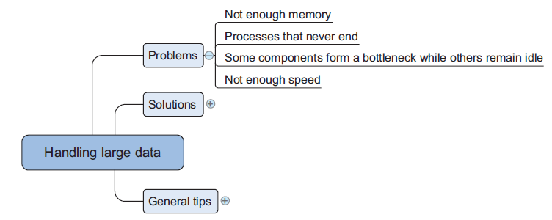
Problems faced when handling large data

Slide 6
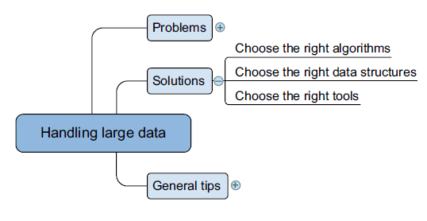
General techniques for handling large volumes of data
Never-ending algorithms, out-of-memory errors, and speed issues are the most common challenges you face when working with large data.

Slide 7
General techniques for handling large volumes of data
No clear one-to-one mapping exists between the problems and solutions because many solutions address both lack of memory and computational performance.
For instance, data set compression will help you solve memory issues because the data set becomes smaller. But this also affects computation speed with a shift from the slow hard disk to the fast CPU.
Contrary to RAM (random access memory), the hard disc will store everything even after the power goes down, but writing to disk costs more time than changing information in the fleeting RAM. When constantly changing the information, RAM is thus preferable over the (more durable) hard disk.

Slide 8
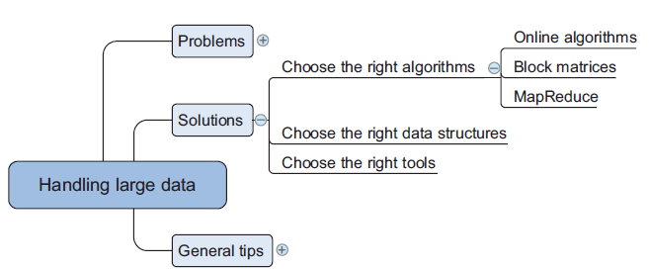
General techniques for handling large volumes of data
An algorithm that’s well suited for handling large data doesn’t need to load the entire data set into memory to make predictions. Ideally, the algorithm also supports parallelized calculations.

Slide 9
General techniques for handling large volumes of data
ONLINE LEARNING ALGORITHMS
Full batch learning (also called statistical learning) —Feed the algorithm all the data at once
Mini-batch learning—Feed the algorithm a spoonful (100, 1000, …, depending on what your hardware can handle) of observations at a time.
Online learning—Feed the algorithm one observation at a time.

Slide 10
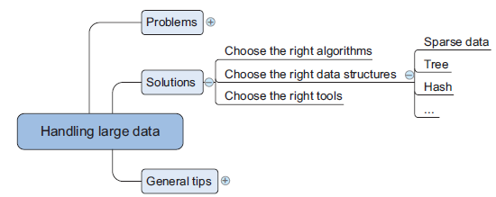
General techniques for handling large volumes of data

Slide 11
General techniques for handling large volumes of data
DIVIDING A LARGE MATRIX INTO MANY SMALL ONES
bcolz - store data arrays compactly and uses the hard drive when the array no longer fits into the main memory
Dask - optimize the flow of calculations and makes performing calculations in parallel easier
MAPREDUCE – easy to parallelize and distribute
MapReduce algorithms are easy to understand with an analogy: Imagine that you were asked to count all the votes for the national elections. Your country has 25 parties, 1,500 voting offices, and 2 million people. You could choose to
gather all the voting tickets from every office individually and count them centrally
ask the local offices to count the votes for the 25 parties and hand over the results to you, and you could then aggregate them by party.

Slide 12
Choosing the right data structure
Algorithms can make or break your program, but the way you store your data is of equal importance.
Data structures have different storage requirements, but also influence the performance of CRUD (create, read, update, and delete) and other operations on the data set.

Slide 13
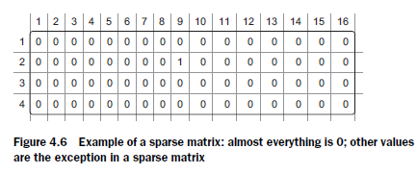
Sparse Matrix
SPARSE DATA
A sparse data set contains relatively little information compared to its entries (observations).

Slide 14
Trees
TREE STRUCTURES
Trees are a class of data structure that allows you to retrieve information much faster than scanning through a table.
A tree always has a root value and subtrees of children, each with its children, and so on.

Slide 15
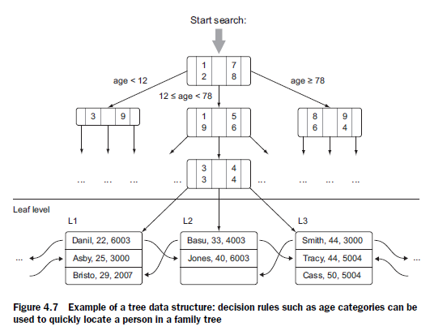
Trees

Slide 16
Trees
Trees are also popular in databases.
Databases prefer not to scan the table from the first line until the last, but to use a device called an index to avoid this.
Indices are often based on data structures such as trees and hash tables to find observations faster. The use of an index speeds up the process of finding data enormously.

Slide 17
Hash Tables
Hash tables are data structures that calculate a key for every value in your data and put the keys in a bucket. This way you can quickly retrieve the information by looking in the right bucket when you encounter the data.
Dictionaries in Python are a hash table implementation, and they’re a close relative of key-value stores.

Slide 18
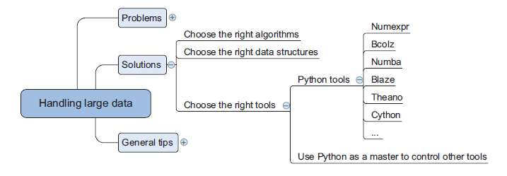
Selecting the right tool
With the right class of algorithms and data structures in place, it’s time to choose the right tool for the job.
The right tool can be a Python library or at least a tool that’s controlled from Python.

Slide 19
Selecting the right tool
Python has a number of libraries that can help you deal with large data. They range from smarter data structures over code optimizers to just-in-time compilers.
Cython
Numexpr
Numba
Bcolz
Blaze
Theano
Dask

Slide 20
Selecting the right tool
Python has a number of libraries that can help you deal with large data. They range from smarter data structures over code optimizers to just-in-time compilers.
Cython - specify the data type while developing the program. Once the compiler has this information, it runs programs much faster.
Numexpr - numerical expression evaluator for NumPy but can be many times faster than the original NumPy
Numba - achieve greater speed by compiling your code right before you execute it, also known as just-in-time compiling.
Bcolz - overcome the out-of-memory problem that can occur when using NumPy. It can store and work with arrays in an optimal compressed form. It not only slims down your data need but also uses Numexpr in the background to reduce the calculations needed when performing calculations with bcolz arrays.

Slide 21
Selecting the right tool
Python has a number of libraries that can help you deal with large data. They range from smarter data structures over code optimizers to just-in-time compilers.
Blaze - if you want to use the power of a database backend but like the “Pythonic way” of working with data. Blaze will translate your Python code into SQL but can handle many more data stores than relational databases such as CSV, Spark, and others.
Theano - work directly with the graphical processing unit (GPU) and do symbolical simplifications whenever possible, and it comes with an excellent just-in-time compiler.
Dask - Dask enables you to optimize your flow of calculations and execute them efficiently. It also enables you to distribute calculations.

Slide 22
General programming tips for dealing with large data sets
■ Don’t reinvent the wheel. Use tools and libraries developed by others.
■ Get the most out of your hardware. Your machine is never used to its full potential; with simple adaptions you can make it work harder.
■ Reduce the computing need. Slim down your memory and processing needs as much as possible.

Slide 23
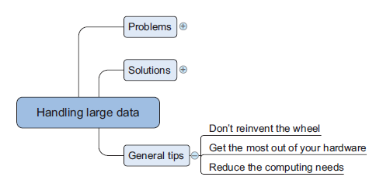
General programming tips for dealing with large data sets

Slide 24
General programming tips for dealing with large data sets
Exploit the power of databases.
The first reaction most data scientists have when working with large data sets is to prepare their analytical base tables inside a database. This method works well when the features you want to prepare are fairly simple. When this preparation involves advanced modeling, find out if it’s possible to employ user-defined functions and procedures.
Use optimized libraries.
Creating libraries like Mahout, Weka, and other machine learning algorithms requires time and knowledge.
They are highly optimized and incorporate best practices and state-of-the art technologies.
Spend your time on getting things done, not on reinventing and repeating others people’s efforts, unless it’s for the sake of understanding how things work.

Slide 25
General programming tips for dealing with large data sets
Get the most out of your hardware
Feed the CPU compressed data - Avoid CPU starvation is to feed the CPU compressed data instead of the inflated (raw) data.
Make use of the GPU - Sometimes your CPU and not your memory is the bottleneck. If your computations are parallelizable, you can benefit from switching to the GPU. This has a much higher throughput for computations than a CPU.
Use multiple threads - It’s still possible to parallelize computations on your CPU. You can achieve this with normal Python threads.

Slide 26
General programming tips for dealing with large data sets
Reduce your computing needs
“Working smart + hard = achievement.”
This also applies to the programs you write.
The best way to avoid having large data problems is by removing as much of the work as possible up front and letting the computer work only on the part that can’t be skipped.

Slide 27
General programming tips for dealing with large data sets
Reduce your computing needs
Profile your code and remediate slow pieces of code – Profiler to detect slow parts inside your program
Use compiled code whenever possible, certainly when loops are involved - Use functions from packages that are optimized for numerical computations
Otherwise, compile the code yourself - just-in-time compiler or implement the slowest parts of your code in a lower-level language such as C or Fortran and integrate
Avoid pulling data into memory - reading data in chunks and parsing the data on the fly. This won’t work on every algorithm but enables calculations on extremely large data sets.
Use generators to avoid intermediate data storage - Generators help you return data per observation instead of in batches.
Use as little data as possible. If no large-scale algorithm is available and you aren’t willing to implement such a technique yourself, then you can still train your data on only a sample of the original data.
Use your math skills to simplify calculations as much as possible.

Slide 28
Data Wrangling
Data Wrangling is referred to as data munging.
It is the process of transforming and mapping data from one "raw" data form into another format to make it more appropriate and valuable for various downstream purposes such as analytics.
The goal of data wrangling is to assure quality and useful data

Slide 29
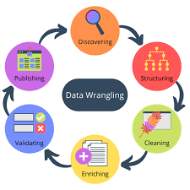
Data Wrangling

Slide 30
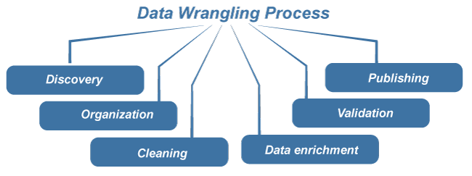
Data Wrangling
Data Wrangling is one of those technical terms that are more or less self-descriptive.
The term "wrangling" refers to rounding up information in a certain way.

Slide 31
Data Wrangling
Discovery: Before starting the wrangling process, it is critical to think about what may lie beneath your data.
Organization: After you've gathered your raw data within a particular dataset, you must structure your data.
Cleaning: When your data is organized, you can begin cleaning your data. Data cleaning involves removing outliers, formatting nulls, and eliminating duplicate data.

Slide 32
Data Wrangling
Data enrichment: This step requires that you take a step back from your data to determine if you have enough data to proceed.
Validation: After determining you gathered enough data, you will need to apply validation rules to your data. Validation rules, performed in repetitive sequences, confirm that data is consistent throughout your dataset.
Publishing: The final step of the data munging process is data publishing. Data providing notes and documentation of your wrangling process and creating access for other users and applications.

Slide 33
Data Wrangling
Use case of Data Wrangling
Fraud Detection
Customer Behavior Analysis

Slide 34
Data Wrangling
Data munging is used for diverse use-cases as follows:
Fraud Detection - Distinguish corporate fraud by identifying unusual behavior by examining detailed information like multi-party and multi-layered emails or web chats.
Customer Behaviour Analysis - A data-munging tool can quickly help your business processes get precise insights via customer behavior analysis.

Slide 35
Data Wrangling Tools
There are different tools for data wrangling that can be used for gathering, importing, structuring, and cleaning data before it can be fed into analytics and BI apps.
Spreadsheets / Excel Power Query- A basic tool for manually cleaning and organizing data.
OpenRefine - An automated data cleaning tool that requires programming skills
Tabula - A tool used to extract data from PDFs.
Google DataPrep - It is a data service that explores, cleans, and prepares data
Data wrangler - It is a data cleaning and transforming tool
Plotly (data wrangling with Python) is useful for maps and chart data.

Slide 36
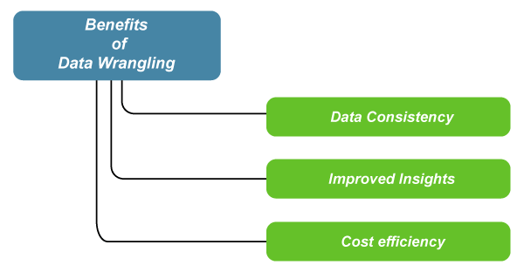
Benefits of Data Wrangling

Slide 37
Benefits of Data Wrangling
Data consistency: The organizational aspect of data wrangling offers a resulting dataset that is more consistent.
Improved insights: Data wrangling can provide statistical insights about metadata by transforming the metadata to be more constant.
Cost efficiency: Data-wrangling allows for more efficient data analysis and model-building processes, businesses will ultimately save money in the long run.

Slide 38
Clean, Transform and Merge
When working with datasets in pandas, you typically follow three major steps:
Cleaning – Handling missing values, duplicates, and inconsistent data
Transforming – Changing data formats, applying functions, feature engineering
Merging – Combining multiple datasets for analysis

Slide 39
Data Cleaning
import pandas as pd
data = {'Name': ['Alice', 'Bob', None, 'David'],
'Age': [25, None, 30, 40],
'City': ['New York', 'Paris', 'London', None]}
df = pd.DataFrame(data)
df_cleaned = df.dropna()
# Fill missing values with default values
df_filled = df.fillna({'Name': 'Unknown', 'Age': df['Age'].mean(), 'City': 'Unknown'})
print(df_filled)

Slide 40
Data Transformation
#Applying Functions to Columns (apply(), map())
df['Age_Category'] = df['Age'].apply(lambda x: 'Young' if x < 30 else 'Old’)
#Changing Data Types (astype())
df['Age'] = df['Age'].astype(int) # Convert float to integer
#Renaming Columns (rename())
df = df.rename(columns={'Name': 'Full_Name'})
#Creating New Columns (assign())
df = df.assign(Age_Squared=df['Age'] ** 2)

Slide 41
Merging data
Using merge() for SQL-like Joins
df1 = pd.DataFrame({'ID': [1, 2, 3], 'Name': ['Alice', 'Bob', 'Charlie']})
df2 = pd.DataFrame({'ID': [1, 2, 4], 'Score': [85, 90, 75]})
merged_df = pd.merge(df1, df2, on='ID', how='left') # Left join

Slide 42
Clean, Transform and Merge
import pandas as pd
# Creating two datasets
df1 = pd.DataFrame({'ID': [1, 2, 3], 'Name': ['Alice', 'Bob', None], 'Age': [25, 30, None]})
df2 = pd.DataFrame({'ID': [1, 2, 4], 'Score': [85, 90, 75]})
# Cleaning: Fill missing values
df1['Name'].fillna('Unknown', inplace=True)
df1['Age'].fillna(df1['Age'].mean(), inplace=True)
# Transforming: Add Age Category
df1['Age_Category'] = df1['Age'].apply(lambda x: 'Young' if x < 30 else 'Old')
# Merging datasets
merged_df = pd.merge(df1, df2, on='ID', how='left')
print(merged_df)

Slide 43
Combining and Merging datasets
Data contained in pandas objects can be combined together in a number of built-in ways:
pandas.merge connects rows in DataFrames based on one or more keys. This will be familiar to users of SQL or other relational databases, as it implements database join operations.
pandas.concat glues or stacks together objects along an axis.
combine_first instance method enables splicing together overlapping data to fill in missing values in one object with values from another.

Slide 44
Combining and Merging datasets
import pandas as pd
df1 = pd.DataFrame({'ID': [1, 2, 3], 'Name': ['Alice', 'Bob', 'Charlie’]})
df2 = pd.DataFrame({'ID': [1, 2, 4], 'Score': [85, 90, 75]})
merged_df = pd.merge(df1, df2, on='ID', how='inner’)
# Inner join
print(merged_df)

Slide 45
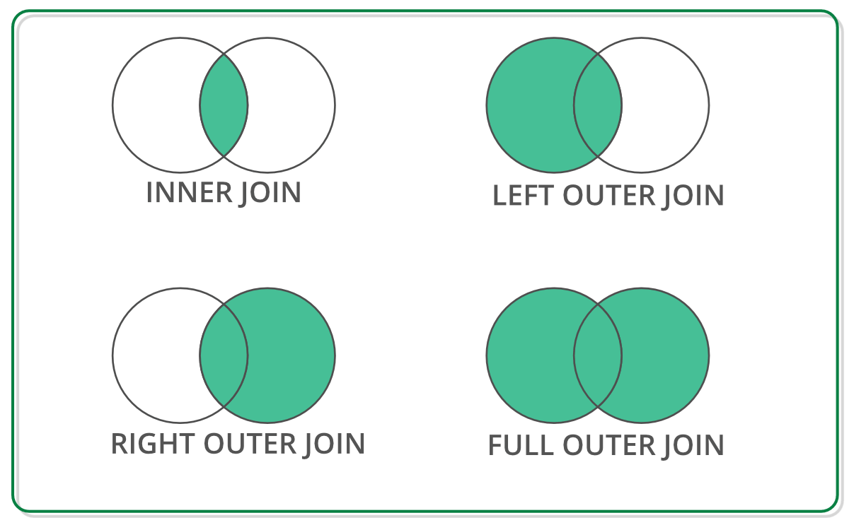
Combining and Merging datasets

Slide 46
Combining and Merging datasets
Concatenating Datasets (concat())
The concat() function is used to stack datasets either vertically (row-wise) or horizontally (column-wise).
Row-wise concatenation
df1 = pd.DataFrame({'ID': [1, 2], 'Name': ['Alice', 'Bob']})
df2 = pd.DataFrame({'ID': [3, 4], 'Name': ['Charlie', 'David']})
concat_df = pd.concat([df1, df2], ignore_index=True) # Stacks them vertically
print(concat_df)

Slide 47
Combining and Merging datasets
Concatenating Datasets (concat())
The concat() function is used to stack datasets either vertically (row-wise) or horizontally (column-wise).
Column-wise concatenation
df1 = pd.DataFrame({'ID': [1, 2], 'Name': ['Alice', 'Bob']})
df2 = pd.DataFrame({'Score': [85, 90]})
concat_df = pd.concat([df1, df2], axis=1) # Joins column-wise
print(concat_df)

Slide 48
Combining and Merging datasets
Joining Datasets (join())
Similar to merge(), but by default, it joins on the index.
df1 = pd.DataFrame({'Name': ['Alice', 'Bob', 'Charlie']}, index=[1, 2, 3])
df2 = pd.DataFrame({'Score': [85, 90, 75]}, index=[1, 2, 4])
joined_df = df1.join(df2, how='outer’)
# Joins based on index
print(joined_df)

Slide 49
Merging on Index
When merging datasets based on the index, you can use either merge() with left_index=True, right_index=True or join(), which is specifically designed for index-based joins.
Using merge() with Indexes
You can merge two DataFrames by their index using merge() with left_index=True and right_index=True.

Slide 50
Merging on Index
import pandas as pd
# Creating two datasets with indexes
df1 = pd.DataFrame({'Name': ['Alice', 'Bob', 'Charlie']}, index=[101, 102, 103])
df2 = pd.DataFrame({'Score': [85, 90, 75]}, index=[101, 102, 104])
# Merging on index
merged_df = pd.merge(df1, df2, left_index=True, right_index=True, how='outer')
print(merged_df)

Slide 51
Merging on Index
2. Using join() for Index-Based Merging
The join() function is simpler and is specifically designed for merging on indexes.
# Joining on index
joined_df = df1.join(df2, how='outer')
print(joined_df)

Slide 52
Merging on Index
Resetting Index Before Merging
If the datasets have an ID column instead of an index, you may need to set the index first.
df1 = pd.DataFrame({'ID': [101, 102, 103], 'Name': ['Alice', 'Bob', 'Charlie']})
df2 = pd.DataFrame({'ID': [101, 102, 104], 'Score': [85, 90, 75]})
# Setting ID as the index
df1.set_index('ID', inplace=True)
df2.set_index('ID', inplace=True)
merged_df = df1.merge(df2, left_index=True, right_index=True, how='outer')
print(merged_df)

Slide 53
Concatenate
Concatenating DataFrames (concat())
Concatenation allows stacking datasets vertically (row-wise) or horizontally (column-wise).
Vertical Concatenation (Row-wise)
import pandas as pd
df1 = pd.DataFrame({'ID': [1, 2], 'Name': ['Alice', 'Bob']})
df2 = pd.DataFrame({'ID': [3, 4], 'Name': ['Charlie', 'David']})
concat_df = pd.concat([df1, df2], ignore_index=True) # Stacks them
print(concat_df)
📌 Key points:
ignore_index=True resets the index after stacking.
By default, it stacks row-wise (axis=0).

Slide 54
Concatenate
Concatenating DataFrames (concat())
Concatenation allows stacking datasets vertically (row-wise) or horizontally (column-wise).
Horizontal Concatenation (Column-wise)
df1 = pd.DataFrame({'ID': [1, 2], 'Name': ['Alice', 'Bob']})
df2 = pd.DataFrame({'Age': [25, 30], 'City': ['NY', 'LA']})
concat_df = pd.concat([df1, df2], axis=1) # Joins column-wise
print(concat_df)
📌 Key points:
axis=1 joins column-wise.
If indices don’t match, missing values (NaN) appear.

Slide 55
Combining with Overlap
Combining with Overlap (combine_first())
This method is used to fill missing values in one DataFrame with values from another.
df1 = pd.DataFrame({'ID': [1, 2, 3], 'Name': ['Alice', 'Bob', None], 'Score': [85, None, 75]})
df2 = pd.DataFrame({'ID': [1, 2, 3], 'Name': [None, 'Bobby', 'Charlie'], 'Score': [None, 90, None]})
# Filling missing values in df1 with df2
combined_df = df1.combine_first(df2)
print(combined_df)
📌 Key points:
It fills missing values (NaN) in df1 with values from df2 only if they exist.
Works element-wise, maintaining the structure.

Slide 56
When to use which method?
Method | Use Case
concat() | Stacking datasets vertically (rows) or horizontally (columns)
merge() | Joining datasets using a common column (like SQL joins)
combine_first() | Filling missing values in one dataset using another

Slide 57
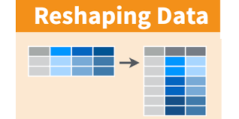
Reshaping
There are a number of fundamental operations for rearranging tabular data.
These are alternatingly referred to as reshape or pivot operations.

Slide 58
Reshaping
Reshaping in pandas refers to changing the structure or layout of a DataFrame. They are:
Pivoting
Melting
Stacking,
Unstacking.

Slide 59
Pivoting
Pivoting Data (pivot() and pivot_table())
Pivoting rearranges data by turning unique values into columns.
Using pivot()
import pandas as pd
df = pd.DataFrame({
'Date': ['2024-01-01', '2024-01-01', '2024-01-02', '2024-01-02'],
'City': ['New York', 'London', 'New York', 'London'],
'Sales': [200, 150, 220, 180] })
pivot_df = df.pivot(index='Date', columns='City', values='Sales’)
print(pivot_df)
📌 Key points:
Converts City values into column names.
Uses Date as the index.
Shows Sales values as table entries.

Slide 60
Melting
Melting Data (melt())
The opposite of pivoting – it converts wide data into long format.
melted_df = pivot_df.reset_index().melt(id_vars='Date', var_name='City', value_name='Sales')
print(melted_df)
📌 Key points:
Converts pivot_df back into a long format.
id_vars keeps specified columns (Date).
var_name and value_name rename the columns.

Slide 61
Stacking and Unstacking
Stacking (stack())
Converts columns into a hierarchical index (multi-index rows).
stacked_df = pivot_df.stack()
print(stacked_df)
Unstacking (unstack())
Converts multi-index rows back into columns.
unstacked_df = stacked_df.unstack()
print(unstacked_df)

Slide 62
Data Cleaning
Data cleaning, also known as data cleansing or data preprocessing, is a crucial step in the data science pipeline that involves identifying and correcting or removing errors, inconsistencies, and inaccuracies in the data to improve its quality and usability.
Data cleaning is essential because raw data is often noisy, incomplete, and inconsistent, which can negatively impact the accuracy and reliability of the insights derived from it.

Slide 63
Why data cleaning is important?
Data cleansing is a crucial step in the data preparation process, playing an important role in ensuring the accuracy, reliability, and overall quality of a dataset.
For decision-making, the integrity of the conclusions drawn heavily relies on the cleanliness of the underlying data. Without proper data cleaning, inccuracies, outliers, missing values, and inconsistencies can compromise the validity of analytical results. Moreover, clean data facilitates more effective modeling and pattern recognition, as algorithms perform optimally when fed high-quality, error-free input.
Additionally, clean datasets enhance the interpretability of findings, aiding in the formulation of actionable insights.

Slide 64
Steps to perform data cleanlines
Removal of unwanted observations
Fixing Structural Errors
Managing Unwanted Outliers
Handling Missing Data

Slide 65
Data Preparation
Data preparation is the process of making raw data ready for after processing and analysis. The key methods are to collect, clean, and label raw data in a format suitable for machine learning (ML) algorithms, followed by data exploration and visualization.
The process of cleaning and combining raw data before using it for machine learning and business analysis is known as data preparation.

Slide 66
Why data preparation is important?
Data preparation ensures data accuracy and consistency, leading to reliable insights and informed decision-making.
It optimizes data for analysis, uncovering hidden patterns and trends. Additionally, it enhances model performance and accuracy, driving better decision outcomes.
It saves time and resources by preventing errors and inefficiencies in the analysis phase.

Slide 67
Steps to perform data preparation
Describe Purpose and Requirements
Data Collection
Combining and Integrating Data
Data Profiling
Data Exploring
Data Transformation and Enrichment

Slide 68
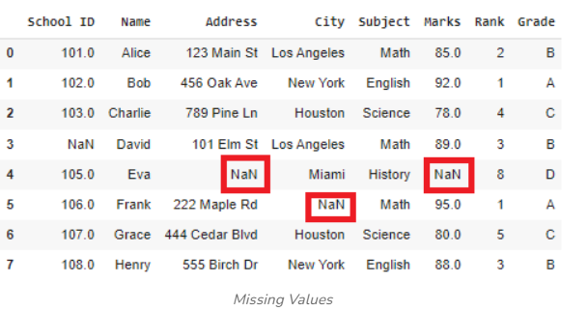
Handling Missing data
What are missing values?
Missing values are data points that are absent for a specific variable in a dataset.
They can be represented in various ways, such as blank cells, null values, or special symbols like “NA” or “unknown.” These missing data points pose a significant challenge in data analysis and can lead to inaccurate or biased results.

Slide 69
Why is it important?
Data Quality: Missing values can introduce errors and inconsistencies into your dataset, leading to inaccurate results and unreliable models.
Model Performance: Many machine learning algorithms cannot handle missing values directly. If not addressed, they can either produce incorrect results or fail to converge.
Bias: Improper handling of missing values can introduce bias into your analysis, leading to misleading conclusions. For example, if missing values are more likely to occur in certain groups, ignoring or deleting them can bias your results.
Data Loss: Deleting rows or columns with missing values can result in significant data loss, especially if there are many missing values. This can reduce the statistical power of your analysis.
Interpretation: Missing values can make it difficult to interpret the results of your analysis. For example, if a variable has many missing values, it may be difficult to draw meaningful conclusions about its relationship with other variables.

Slide 70
Techniques to handle missing data
Techniques
Deletion
Imputation

Slide 71
Deletion
Listwise Deletion: Remove entire rows or columns containing missing values. This method is simple but can result in a significant loss of data, especially if there are many missing values.
Pairwise Deletion: Remove pairs of observations where at least one value is missing. This is less wasteful than listwise deletion but can introduce bias if missingness is not random.

Slide 72
Imputation
Mean/Median/Mode Imputation: Replace missing values with the mean, median, or mode of the respective column. This is a simple approach but can introduce bias if the distribution is skewed.
K-Nearest Neighbors (KNN) Imputation: Impute missing values using the average values of the k nearest neighbors. This method can be effective for numerical data.
Regression Imputation: Use regression models to predict missing values based on other features. This is suitable for numerical data with strong relationships between features.
Multiple Imputation: Create multiple imputed datasets by filling in missing values with different plausible values. This method can help to account for uncertainty in the imputation process.

Slide 73
Handling missing values
import pandas as pd
import numpy as np
# Creating a sample dataframe with missing values
data = {'Name': ['Alice', 'Bob', 'Charlie', 'David', np.nan],
'Age': [25, np.nan, 30, 22, 35],
'Salary': [50000, 54000, np.nan, 42000, 48000]}
df = pd.DataFrame(data)
print("Original DataFrame:")
print(df)

Slide 74
Handling missing values
1)Check for missing values
print(df.isnull()) # Boolean DataFrame indicating missing values
print(df.isnull().sum()) # Count of missing values in each column
2)Removing missing values
#Drop rows with missing values
df_cleaned = df.dropna()
print(df_cleaned)
#Drop columns with missing values
df_cleaned = df.dropna(axis=1)
print(df_cleaned)

Slide 75
Handling missing values
3) Filling missing values
#Fill with a specific value
df_filled = df.fillna(0)
print(df_filled)
#Fill with column mean, median and mode
df['Age'].fillna(df['Age'].mean(), inplace=True) # Mean
df['Salary'].fillna(df['Salary'].median(), inplace=True) # Median
df['Name'].fillna(df['Name'].mode()[0], inplace=True) # Mode
print(df)

Slide 76
Handling missing values
3) Forward and backward fill
#Forward fill (propagates previous values #forward)
df_ffill = df.fillna(method='ffill')
print(df_ffill)
#Backward fill (propagates next value #backward)
df_ffill = df.fillna(method='ffill')
print(df_ffill)

Slide 77
Choosing the right approach
The best approach for handling missing values depends on the nature of your data, the amount of missing data, and the specific requirements of your analysis. Consider the following factors:
Amount of missing data: If there are many missing values, imputation might be preferable to deletion.
Distribution of missing data: If missingness is random, imputation might be suitable. If missingness is related to other variables, more sophisticated techniques might be necessary.
Impact of missing data on the analysis: If missing values are likely to bias your results, it's important to address them.
By carefully considering these factors and applying appropriate techniques, you can effectively handle missing values in your data science projects and improve the accuracy and reliability of your models.

Slide 78
Choosing the right approach
The best approach for handling missing values depends on the nature of your data, the amount of missing data, and the specific requirements of your analysis. Consider the following factors:
Amount of missing data: If there are many missing values, imputation might be preferable to deletion.
Distribution of missing data: If missingness is random, imputation might be suitable. If missingness is related to other variables, more sophisticated techniques might be necessary.
Impact of missing data on the analysis: If missing values are likely to bias your results, it's important to address them.
By carefully considering these factors and applying appropriate techniques, you can effectively handle missing values in your data science projects and improve the accuracy and reliability of your models.

Slide 79
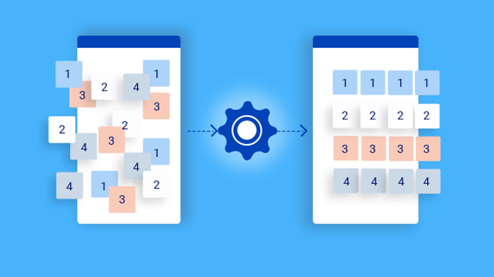
Data Transformation
Data transformation is the process of converting, cleansing, and structuring data into a usable format that can be analyzed to support decision making processes, and to propel the growth of an organization.
Data transformation is used when data needs to be converted to match that of the destination system.

Slide 80
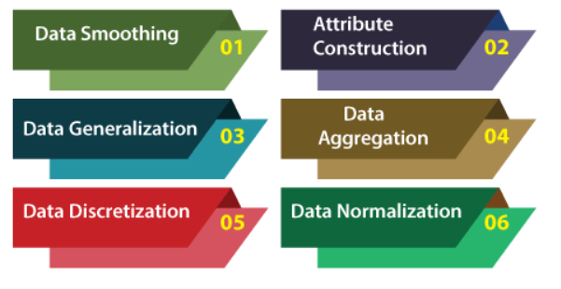
Data Transformation Techniques

Slide 81
Data Smoothing
Data smoothing is a process that is used to remove noise from the dataset using some algorithms.
It allows for highlighting important features present in the dataset.
It helps in predicting the patterns.
When collecting data, it can be manipulated to eliminate or reduce any variance or any other noise form.

Slide 82
Attribute Construction
In the attribute construction method, the new attributes consult the existing attributes to construct a new data set that eases data mining.
New attributes are created and applied to assist the mining process from the given attributes. This simplifies the original data and makes the mining more efficient.

Slide 83
Data Generalization
Data generalization is the process of converting detailed data into a more abstract, higher-level representation while retaining essential information.
It is commonly used in data mining, privacy preservation, and machine learning to reduce complexity and improve model generalization.
Types
Attribute Generalization
Hierarchical Generalization
Numeric Generalization
Text Generalization

Slide 84
Data Generalization
Attribute Generalization
Replacing specific values with more general categories.
Example:
Raw Data: Age = {22, 25, 30, 35}
Generalized Data: Age Group = {20-30, 30-40}
2) Hierarchical Generalization
Using a hierarchy to replace specific values with broader categories.
Example:
Raw Data: "Toyota Corolla" → Generalized: "Toyota" → "Car"
Numeric Generalization

Slide 85
Data Generalization
3) Numeric Generalization
Converting continuous numerical data into categorical ranges.
Example:
Raw Data: Salary = {45000, 52000, 61000}
Generalized: Salary Range = {40K-50K, 50K-60K, 60K-70K}
4) Text Generalization
Replacing specific words with generalized versions.
Example:
Raw Data: "John lives in New York"
Generalized: "Person lives in City"

Slide 86
Data Aggregation
Data collection or aggregation is the method of storing and presenting data in a summary format.
The data may be obtained from multiple data sources to integrate these data sources into a data analysis description. This is a crucial step since the accuracy of data analysis insights is highly dependent on the quantity and quality of the data used.

Slide 87
Data Discretization
Data discretization is the process of converting continuous numerical data into discrete categories (bins).
It is commonly used in machine learning, data mining, and feature engineering to simplify models and improve Interpretability.
# Sample dataset
data = {'Age': [22, 25, 30, 35, 40, 45, 50, 55, 60]}
df = pd.DataFrame(data)
# Equal-width binning into 3 categories df['Age_Binned'] = pd.cut(df['Age'], bins=3, labels=['Young', 'Middle-aged', 'Old’])
print(df)

Slide 88
Data Normalization
Data normalization is a preprocessing technique used to scale numerical data into a specific range, usually [0,1] or [-1,1].
It ensures that features contribute equally to a model, preventing bias due to different scales.
Why Normalize Data?
✅ Improves Machine Learning Performance – Many algorithms (e.g., KNN, SVM, Neural Networks) perform better with normalized data. ✅ Speeds Up Convergence – Gradient descent optimizes faster when features are scaled. ✅ Prevents Dominance of Large-Scale Features – Avoids a situation where one feature overpowers others.

Slide 89
String manipulation
Strings are fundamental and essential data structures that every Python programmer works with.
In Python, a string is a sequence of characters enclosed within either single quotes ('...') or doubles quotes ("...").
It is an immutable built-in data structure, meaning once a string is created, it cannot be modified. However, we can create new strings by concatenating or slicing existing strings.

Slide 90
String manipulations
Basic String Operations
# Defining a string
text = "Hello, Python!"
# String length
print(len(text)) # 14
# Accessing characters
print(text[0]) # 'H'
print(text[-1]) # '!'
# Slicing a string
print(text[0:5]) # 'Hello'
print(text[:5]) # 'Hello'
print(text[7:]) # 'Python!'
# Reversing a string
print(text[::-1]) # '!nohtyP ,olleH'

Slide 91
String manipulations
String Case Manipulation
text = "hello python"
print(text.upper()) # 'HELLO PYTHON'
print(text.lower()) # 'hello python'
print(text.title()) # 'Hello Python'
print(text.capitalize()) # 'Hello python'
print(text.swapcase()) # 'HELLO PYTHON'

Slide 92
String manipulations
String Concatenation and Repetition
str1 = "Hello"
str2 = "Python"
# Concatenation
print(str1 + " " + str2) # 'Hello Python'
# Repetition
print(str1 * 3) # 'HelloHelloHello'

Slide 93
String manipulations
String Searching and Replacing
text = "Python is fun"
# Check if substring exists
print("Python" in text) # True
print("Java" not in text) # True
# Find position
print(text.find("fun")) # 10
print(text.index("is")) # 7
# Replace substring
print(text.replace("fun", "awesome")) # 'Python is awesome'

Slide 94
String manipulations
Splitting and Joining Strings
text = "apple,banana,grape"
# Splitting a string into a list
fruits = text.split(",")
print(fruits) # ['apple', 'banana', 'grape']
# Joining a list into a string
new_text = "-".join(fruits)
print(new_text) # 'apple-banana-grape'

Slide 95
String manipulations
Removing whitespaces
text = " Python "
print(text.strip()) # 'Python'
print(text.lstrip()) # 'Python '
print(text.rstrip()) # ' Python'

Slide 96
String manipulations
Formatting Strings
name = "Alice"
age = 25
# Using f-strings (Python 3.6+)
print(f"My name is {name} and I am {age} years old.")
# Using format()
print("My name is {} and I am {} years old.".format(name, age))
# Using % operator
print("My name is %s and I am %d years old." % (name, age))

Slide 97
String manipulations
Checking String properties
text = "Python123"
print(text.isalpha())#False(containsnumbers)
print(text.isdigit())#False(contains letters)
print(text.isalnum()) # True (letters and numbers only)
print(text.isspace()) # False (not just spaces)
print("hello".islower()) # True
print("HELLO".isupper()) # True

Slide 98
String manipulations
Reversing words in a sentence
text = "Hello World"
reversed_words = " ".join(text.split()[::-1])
print(reversed_words) # 'World Hello'

Slide 99
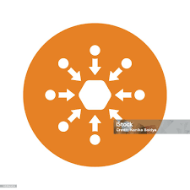

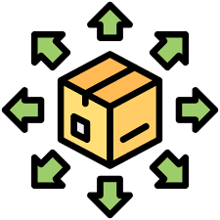
Summarizing
Data summarization is the process of reducing the complexity and size of data by extracting its main patterns, trends, and features.
Centrality
Mean
Median
Mode
Dispersion
Standard Deviation
Variance
Range
Sample Distribution
Histogram
Skewness
Kurtosis

Slide 100
Summarizing
Centrality
Centrality of a data describes the center or middle value of the data set.
The common measures of centrality are:
Mean: The average value of a dataset.
Mode: The most frequent value in a dataset.
Median: The middle value in a sorted dataset.

Slide 101
Summarizing
Dispersion
This category measures how spread out the data is.
The common measures of dispersion are:
Standard Deviation: Measures the average distance of data points from the mean.
Variance: The square of the standard deviation.
Range: The difference between the maximum and minimum values.

Slide 102
Summarizing
Sample Distribution
This category involves analyzing the shape and characteristics of the distribution of the data.
The common methods under this category are:
Histogram: A graphical representation of the distribution of a numerical variable.
Tally: A simple counting method.
Skewness: Measures the asymmetry of the distribution.
Kurtosis: Measures the "tailedness" of the distribution.

Slide 103
Binning
Binning is the process of grouping continuous values into discrete bins (intervals).
It is commonly used in data preprocessing, feature engineering, and data visualization to reduce complexity and improve interpretability.

Slide 104
Binning
Types of Binning
Equal-Width Binning
Divides the data into equal-sized intervals.
Example: Ages (22, 25, 30, 35, 40) → Bins: [20-30], [30-40], etc.
Equal-Frequency Binning (Quantile Binning)
Each bin contains (almost) the same number of values.
Example: 5 salaries split into 3 bins, each with ~2 values.
Custom Binning
Manually defining bins based on domain knowledge.
Example: Categorizing income levels → Low, Medium, High.

Slide 105
Standardization
Standardization is a common preprocessing technique in data science that transforms numerical data to have a mean of 0 and a standard deviation of 1.
This is particularly useful when dealing with features that have different scales or units, as it ensures that all features contribute equally to the model.

Slide 106
Why Standardization?
Equalizes Feature Importance: Standardization prevents features with larger magnitudes from dominating the model, ensuring that all features are treated fairly.
Improves Model Performance: Many machine learning algorithms, especially those based on distance or gradient calculations, benefit from standardized data.
Compatibility with Certain Algorithms: Some algorithms, like K-Nearest Neighbors and Support Vector Machines, assume standardized data.

Slide 107
Standardization
Standardization
Z-Score
Min-max

Slide 108
Standardization
Z-score normalization is a data preprocessing technique that transforms numerical data to have a mean of 0 and a standard deviation of 1. This is particularly useful when dealing with features that have different scales or units, as it ensures that all features contribute equally to the model.
The formula used is:
z = (x - mean) / standard_deviation
where:
z is the normalized value.
x is the original value.
mean is the mean of the dataset.
standard_deviation is the standard deviation of the dataset.

Slide 109
Standardization
Min-max normalization is a data preprocessing technique that scales numerical data to a specific range, typically between 0 and 1. It's useful when you want to preserve the relative distances between data points while ensuring that all features have a similar scale.
The formula used is:
x_scaled = (x - min(x)) / (max(x) - min(x))
where:
x_scaled is the normalized value.
x is the original value.
min(x) is the minimum value in the dataset.
max(x) is the maximum value in the dataset.

Slide 110
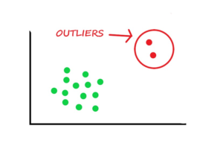
Outlier Noise
Outlier Noise or Outliers are the data points which deviate significantly from the norm.
Outliers can be single data points, or a subset of observations called a collective outlier.
The outlier data points can greatly impact the accuracy and reliability of statistical analyses and machine learning models.
Outliers can also be called abnormalities, discordant, deviants, or anomalies.

Slide 111
Outlier Noise
Types of Outliers
Global Outliers
Contextual Outliers

Slide 112
Types of Outliers
Global outliers
Global outliers are isolated data points that are far away from the main body of the data.
They are often easy to identify and remove.
Contextual outliers
Contextual outliers are data points that are unusual in a specific context but may not be outliers in a different context.
They are often more difficult to identify and may require additional information or domain knowledge to determine their significance.

Slide 113
Anamolies
A data object that deviates significantly from normal objects, such as an unusual credit card purchase.
Anomalies can also be instances or collections of data that are very rare in the data set and have features that differ significantly from most of the data.
Anomalies can be contextual outliers, which are anomalies that have values that significantly deviate from other data points in the same context. For example, an anomaly in one dataset might not be an anomaly in another.

